Slide 1

Global Economic & Demographic Trends Analysis
Name : V Dhanasekaran
Course : DA & DS
Batch : April 2025

Slide 2
Project Overview
SQl
Excel
Power BI
Dashboard
Objective: To analyze and visualize global population, GDP, literacy, and health indicators.
Data from SQL and Excel sources integrated in Power BI.
Perform data cleaning, transformation, DAX calculations, and statistical analysis.
Final deliverable: An interactive Power BI dashboard for insights on global trends.

Slide 3
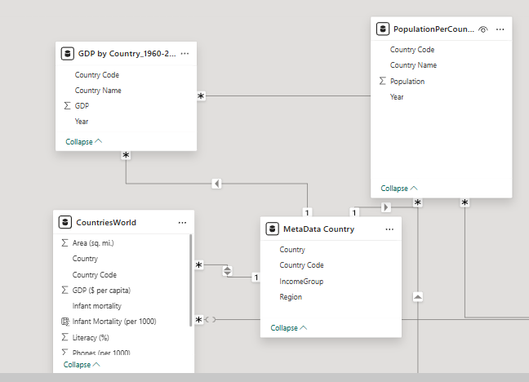
Datasets Used
SQL Dataset: CountriesWorld
Contains: Country, Region, GDP, Literacy, Infant Mortality, Area, Population, etc.
Excel Datasets:
Population Per Country → Population data (1960–2016)
GDP by Country → GDP data (1960–2016)
Meta Data → Region, Income Group, Special Notes

Slide 4
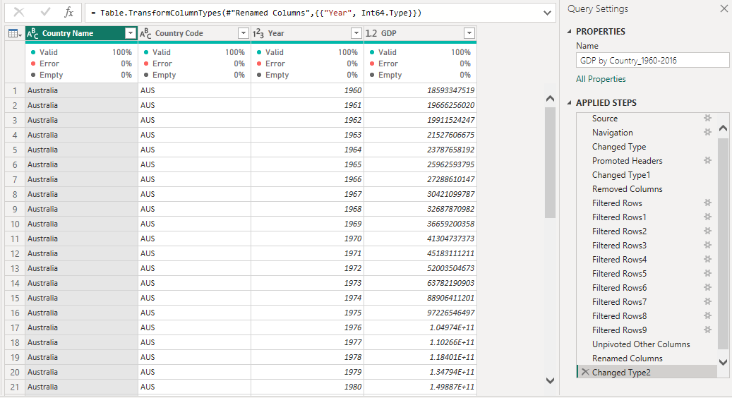
Data Cleaning & Transformation
Imported all datasets into Power BI using Power Query Editor.
Cleaned duplicates and null values.
Transformed data types (numeric, text, date).
Merged tables using Country Name / Code.
Ensured consistency across all datasets.

Slide 5
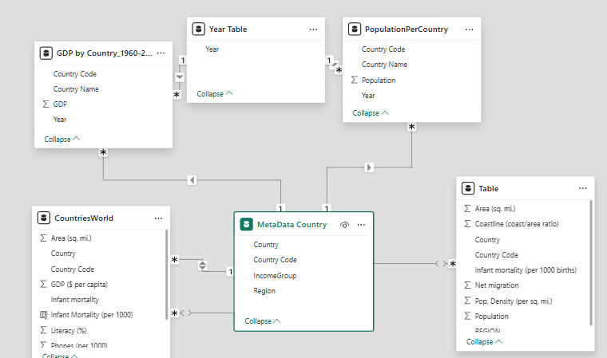
Data Modelling
Created relationships between SQL and Excel tables.
Key relationship: Country Name / Country Code.
Built Data Model with connected tables for Population, GDP, and Country details.
Ensured referential integrity and clean model structure.

Slide 6
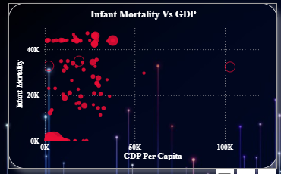
.
Statistical Analysis (Descriptive)
Mean, Median, Mode, and Standard Deviation for Population & GDP.
GDP per Capita, Literacy Rate, and Infant Mortality analyzed region-wise.
Distribution of GDP and Infant Mortality shown using histograms & boxplots

Slide 7
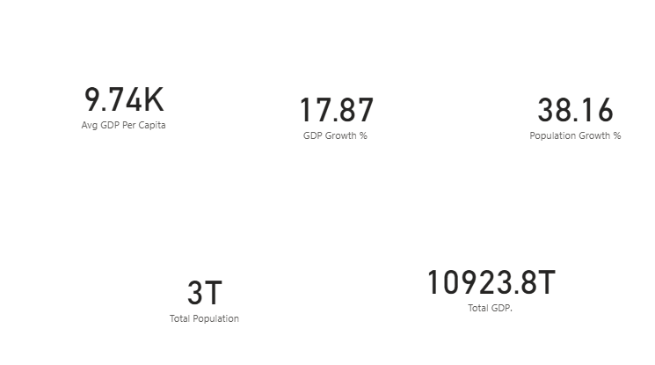
DAX Calculations
Created DAX Measures :
Avg GDP Per Capita
Population Growth %
GDP Growth%
Total GDP
Total Population
Used To Calculate Average, Sum, Divide, Return and Variance

Slide 8
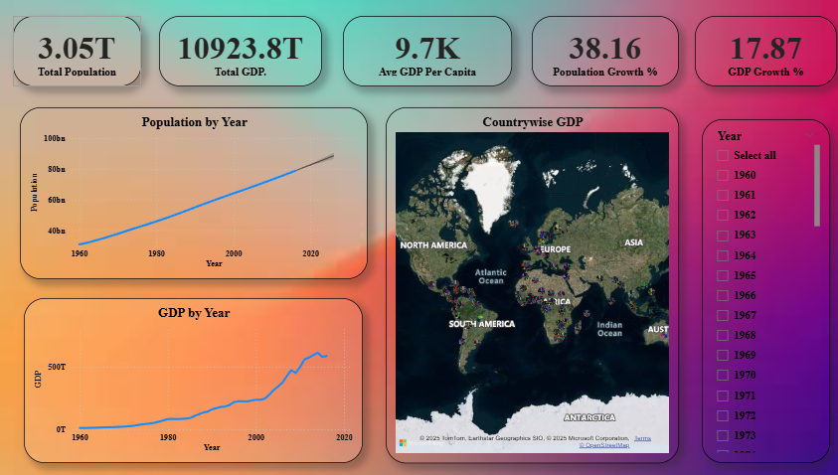
.
Data Visualization & Dashboard
Dashboard created using multiple visual types:
Bar, Line, Map, Scatter, Area, Pie Charts.
Used slicers for Region, Year, and Country selection.
Dashboard design emphasizes clarity and interactivity

Slide 9
Key Insights
Population Trends: Asia shows the highest population growth over 1960–2017.
GDP Insights: Developed regions have higher GDP per capita; emerging regions show faster GDP growth.
Infant Mortality: Inversely correlated with GDP per capita.
Literacy Rate: Positively correlated with GDP per capita and life expectancy.
Regional Comparison: North America and Europe top in GDP per capita, Africa shows rapid growth in literacy.

Slide 10
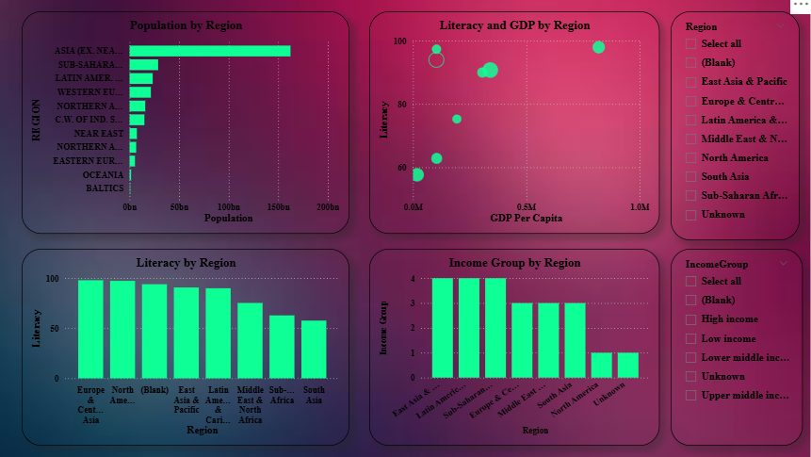
.
Dashboard Highlights
5+ visual types used for analysis.
Region and Country-level filters.
Interactive storytelling layout.
Clear KPIs (Top GDP, Growth %, Literacy, Mortality).
Rolling averages and trend lines show long-term growth

Slide 11
Conclusion
Power BI helped combine multiple data sources into one interactive model.
DAX and descriptive statistics provided deeper insights into world development trends.
Visual analytics simplified the comparison of key indicators.
Future work: Add more recent data or predictive analysis using machine learning.

